Slide 1
HTML Basics
By Jinzhu Gao

Slide 2
Objectives
Learn the basics of HTML and web pages
Get familiar with web standards

Slide 3
Web Page
A well-written web page:
HTML: the content of the document
Style Sheets (in CSS): the appearance of the document
Scripts (in languages such as JavaScript): the behavior of the document

Slide 4
HTML Document
A text file named with an .html extension
Text content: information the user will see
HTML markup: tags that describe the content and tell the browser how to structure and display it
index.html:
Represent the main page for a particular web site:
http://www.example.com/
is equivalent to:
http://www.example.com/index.html

Slide 5
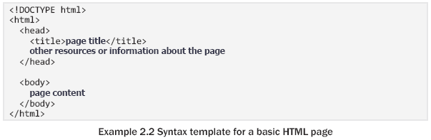
Page Structure
Required for any web page
General info
Content to display
Required for any web page

Slide 6
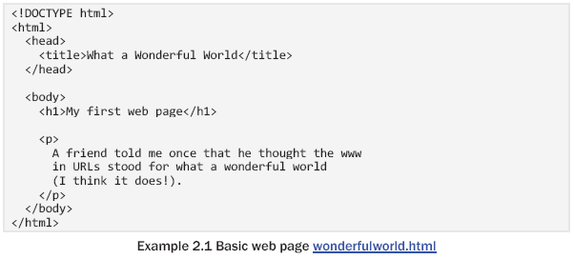
Hypertext Markup Language (HTML)
Describes the contents of a web page, such as headings, paragraphs, images and lists

Slide 7
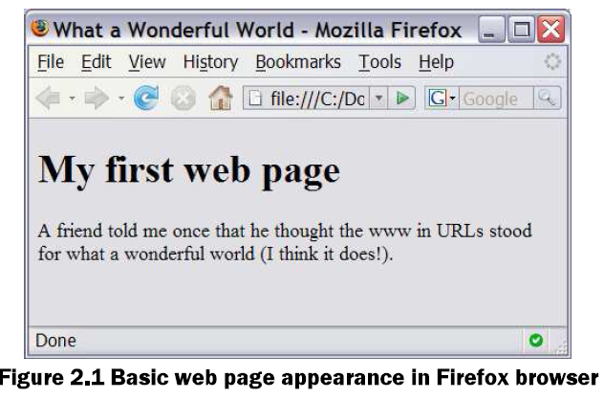
Hypertext Markup Language (HTML)
Describes the contents of a web page, such as headings, paragraphs, images and lists

Slide 8
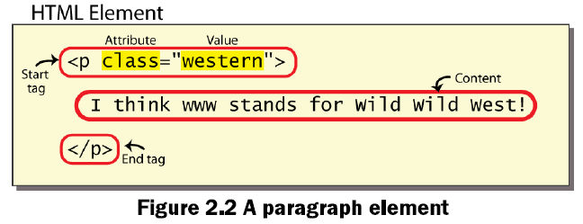
HTML Document
Tags: consist of a lowercase tag name surrounded by angle brackets
Element: a pair of HTML tags and their enclosed content

Slide 9
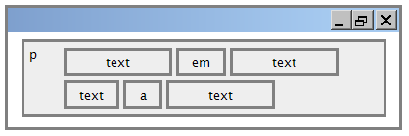
Element
Block elements: contain an entire large region of content
Paragraphs, list, table cells
Inline elements: affect a small amount of content
Bold text, code fragments, images
The browser allow many inline elements to appear on the same line
Must be nested inside a block element

Slide 10
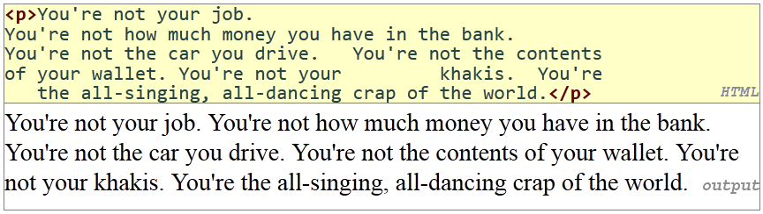
Block Elements
Paragraphs (p)
Element | p
Description | Paragraph of text (block)
Syntax | <p> content </p>

Slide 11
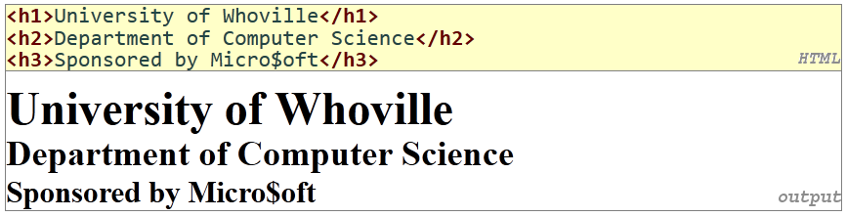
Block Elements
Headings (h1-h6)
Elements | h1, h2, h3, h4, h5, h6
Description | Headings to label/separate sections of the page (block)
Syntax | <h1> content </h1> <h2> content </h2> … <h6> content </h6>
Notes:
Semantic HTML: Choosing tags based on the meaning of the content rather than on its appearance

Slide 12
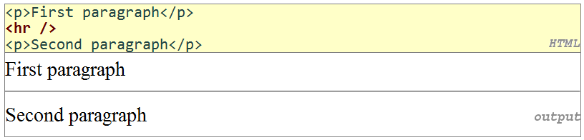
Block Elements
Horizontal Rule (hr)
Element | hr
Description | Horizontal rule, a line to separate sections (block)
Syntax | HTML: <hr> XHTML: <hr />
Notes:
It is an empty element
https://www.youtube.com/watch?v=PznTdEXh8sM

Slide 13
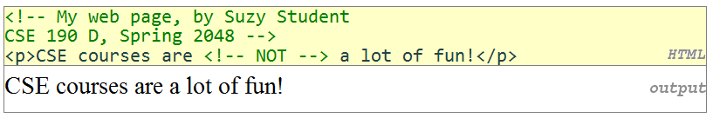
Block Elements
Comments
Description | Comments (to document or “comment out” text)
Syntax | <! -- text -->
Notes:
There cannot be another pair of hyphens in the comment until the closing --> tag

Slide 14
Inline Elements
Some tags can contain additional information called attributes
syntax:
<element attribute="value" attribute="value"> content </element>
example:
<a href="page2.html">Next page</a>
Some tags don't contain content; can be opened and closed in one tag
syntax:
<element attribute="value" attribute="value" />
example:
<hr />
<img src="bunny.jpg" alt="pic from Easter" />

Slide 15
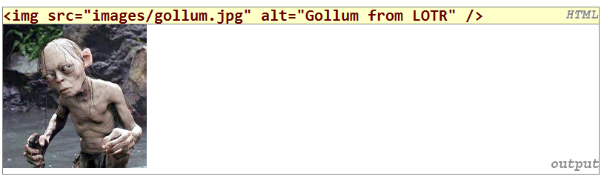
Inline Elements
Images(img)
Element | img
Description | Image (inline)
Syntax | <img src=“URL” alt=“description” />
Attribute: a piece of additional info about an element

Slide 16
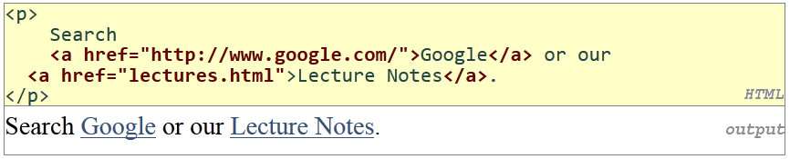
Inline Elements
Links(a)
Element | a
Description | Anchor or link (inline)
Syntax | <a href=“URL”>content</a>
Notes:
Alt is for accessibility (required, alternative text to display if image cannot be loaded) and title is for tooltips when the user hovers the mouse cursor over the image. IE mistakenly displays alt values as tooltips.

Slide 17
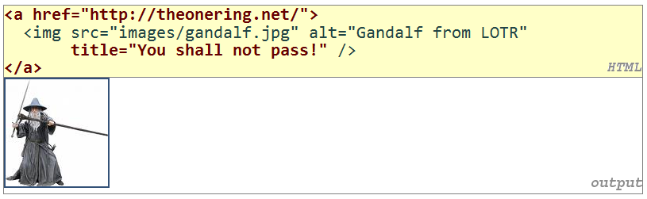
Inline Elements
Links(a)
Element | a
Description | Anchor or link (inline)
Syntax | <a href=“URL”>content</a>
Notes:
Alt is for accessibility (required, alternative text to display if image cannot be loaded) and title is for tooltips when the user hovers the mouse cursor over the image. IE mistakenly displays alt values as tooltips.

Slide 18
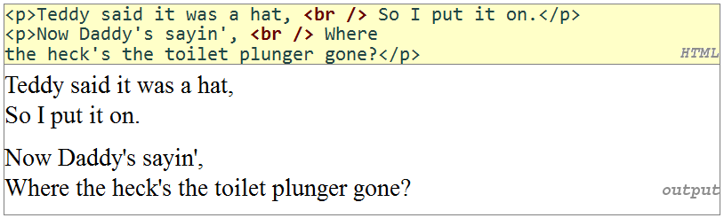
Inline Elements
Line Breaks(br)
Element | br
Description | Line break (inline)
Syntax | <br />
Notes:
Don't over-use br (guideline: >= 2 in a row is bad)

Slide 19
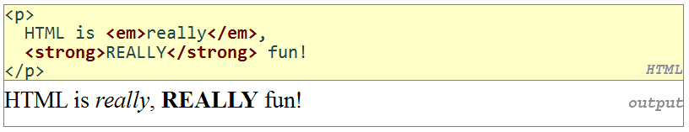
Inline Elements
Emphasis (em, strong)
Element(s) | Em | strong
Description | Emphasis (inline) | Strong emphasis (inline)
Syntax | <em>content</em> | <strong>…</strong>

Slide 20
Web Standards
A general group of formal standards and technical specifications for various aspects of the WWW
Why follow standards?
Standards-compliant pages are
more rigid and structured language
more interoperable across different web browsers
more likely that our pages will display correctly in the future
can be interchanged with other XML data: SVG (graphics), MathML, MusicML, etc.

Slide 21
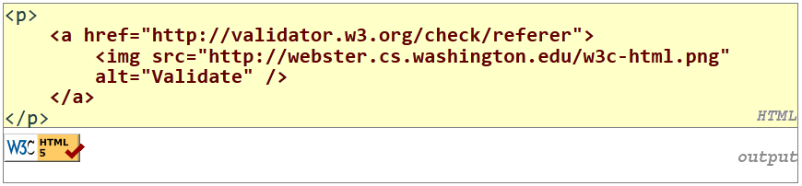
W3C HTML Validator
http://validator.w3.org
Add a link on any page you create, and when clicked, will run the W3C validator on that page

Slide 22
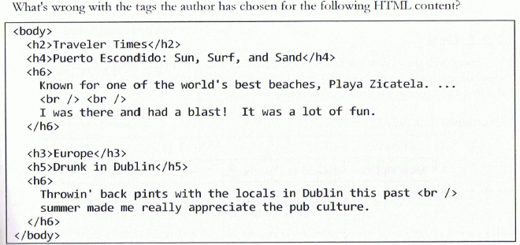
Self-check
Notes:
Lower level headings should only be used under headings of the next higher level. Headings represent a hierarchy of the sections of a web page.
Placing two br elements in a row is a bad style

Slide 23
In-class Assignment
Go to http://www.w3schools.com/tags/ and test sample codes in this chapter/previous slides.
Check http://training.pacificescience.com/jgao/COMP127/ for more code example on HTML

Slide 24
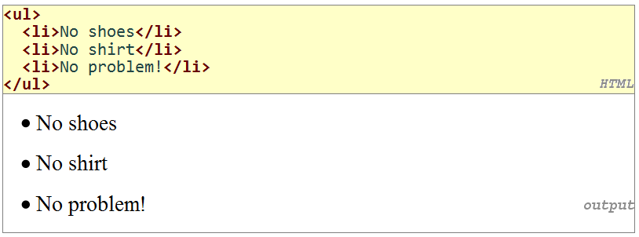
More HTML Elements
Unordered lists (ul, li)
Element(s) | ul | li
Description | Unordered list (block) | List item (block)
Syntax | <ul> <li>content</li> … <li>content</li> </ul> | <li>content</li>

Slide 25
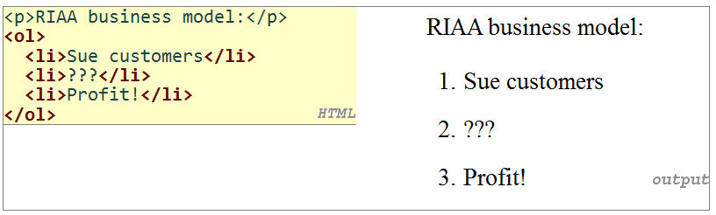
More HTML Elements
Ordered lists (ol, li)
Element(s) | ol | li
Description | Ordered or numbered list (block) | List item (block)
Syntax | <ol> <li>content</li> … <li>content</li> </ol> | <li>content</li>

Slide 26
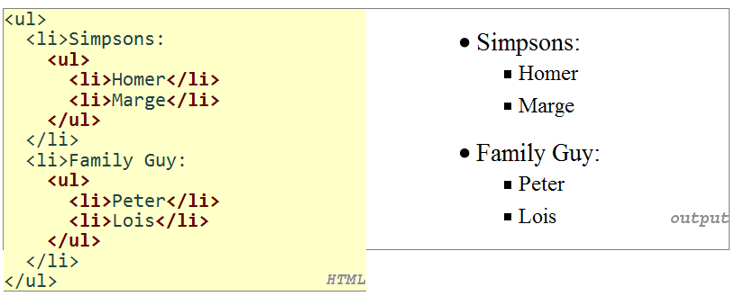
More HTML Elements
Nested lists
Notes:
A list can contain other lists

Slide 27
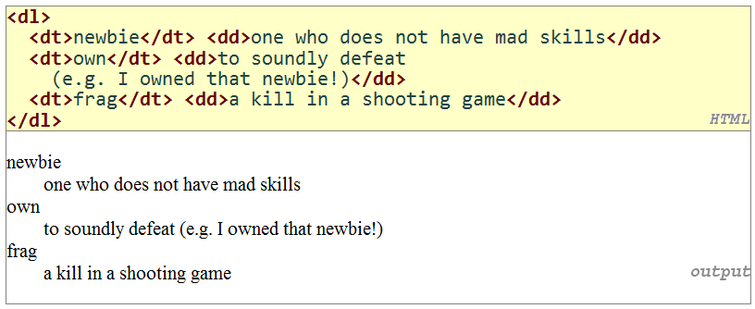
More HTML Elements
Definition lists (dl, dt, dd)
Element | dl | dt | dd
Description | Definition list (block) | Term (block) | Description/definition
Syntax | <dl> <dt>content</dt> <dd>content</dd> … <dt>content</dt> <dd>content</dd> </dl> | <dt>content</dt> | <dd>content</dd>
Notes:
dl: definition list (block)
dt: term (block)
dd: Description/definition (block)

Slide 28
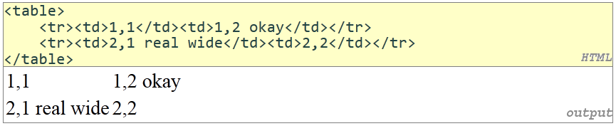
More HTML Elements
Tables
Element | table | tr | td | th | caption
Description | Table(block) | Row | Cell (Column) | Heading | Table caption
Syntax | <table> <caption>content</caption> <tr><th>column title</th>.. .<th>column title</th></tr> <tr><td>content</td>.. .<td>content</td></tr> … <tr><td>content</td>.. .<td>content</td></tr> </table>

Slide 29
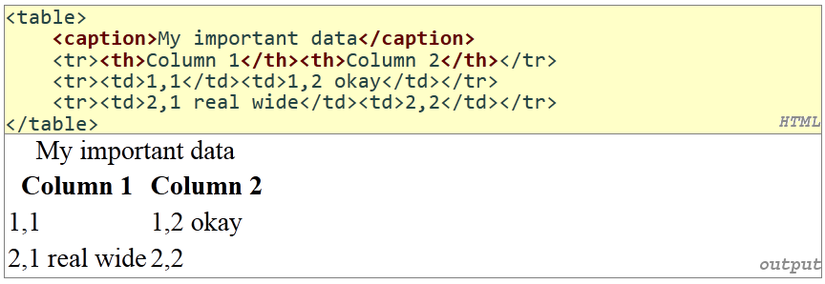
More HTML Elements
Tables
Element | table | tr | td | th | caption
Description | Table(block) | Row | Cell (Column) | Heading | Table caption
Syntax | <table> <caption>content</caption> <tr><th>column title</th>.. .<th>column title</th></tr> <tr><td>content</td>.. .<td>content</td></tr> … <tr><td>content</td>.. .<td>content</td></tr> </table>

Slide 30

More HTML Elements
Inline quotations (q)
Element | q
Description | Short quotation (inline)
Syntax | <q>content</q>

Slide 31
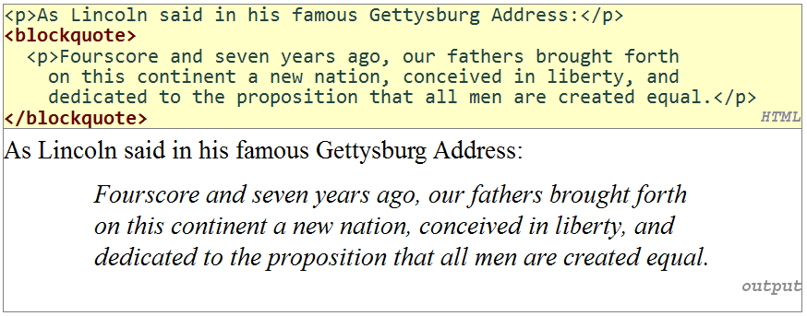
More HTML Elements
Block quotations (blockquote)
Element | blockquote
Description | Long quotation (block)
Syntax | <blockquote> content </blockquote>

Slide 32
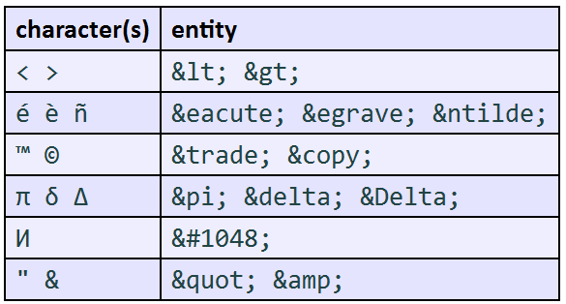
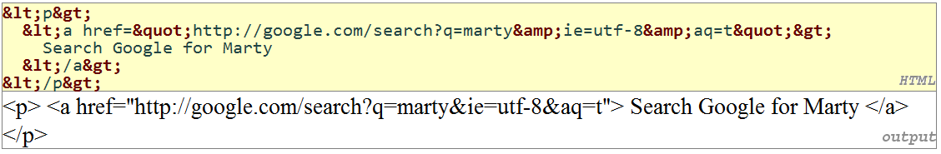
Pre-Formatted Text
HTML Symbols
Notes:
How to write a web page about writing web pages?
How to display a special character on the web page?

Slide 33
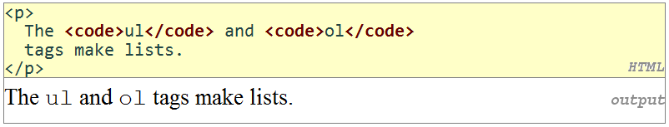
Pre-Formatted Text
Computer Code (code)
Element | code
Description | Computer code (inline)
Syntax | <code>content</code>

Slide 34
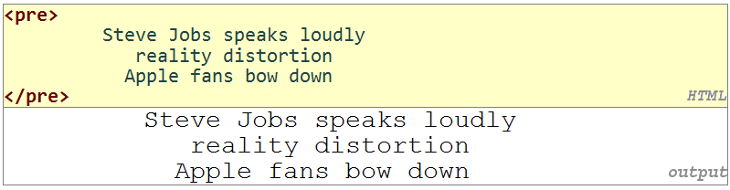
Pre-Formatted Text
Preformatted Text (pre)
Element | pre
Description | Pre-formatted text (block)
Syntax | <pre> content </pre>
Notes:
The pre block can contain inline elements such as anchors, emphasis, and images
Usually the browser collapses any span of whitespace in an element’s content down to a single space.
Here exact whitespace does matter

Slide 35
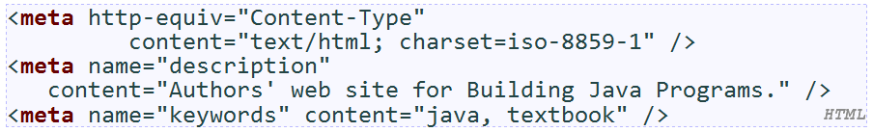
Web page metadata: <meta>
Information about your page
Placed in the head section
meta tags often have both the name and content attributes
some meta tags use the http-equiv attribute instead of name
use a meta tag Content-Type stops validator "tentatively valid" warnings
Notes:
Search engines can more easily learn how to catalog your page when they examine it.
Help redirect the browser when a page moves
meta tags often have both the name and content attributes
some meta tags use the http-equiv attribute instead of name
using a meta tag Content-Type stops validator "tentatively valid" warnings

Slide 36
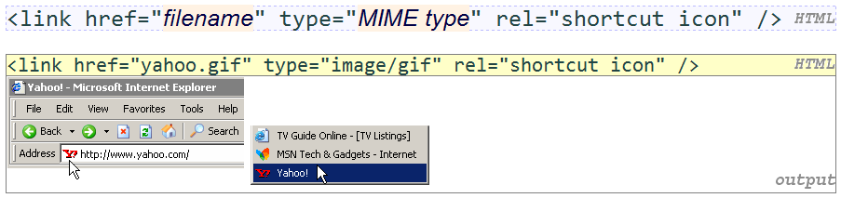
Favorites icon (“favicon”)
A small image that will show up when it is displayed in the browser or as a bookmark
Placed in the head section
For IE6, must put a file favicon.ico in the root of the web server (info)

Slide 37
HTML 5
A new W3C standard version of the HTML markup language
Successor to HTML 4.01 and XHTML 1.1
Balance between too-loose-ness of HTML 4 and too-strict-ness of XHTML
Reduces the browser's need for plugins to display content, e.g. multimedia
Make web content more rich, semantically meaningful, descriptive, accessible
More easily enable the web as an application platform (Web 2.0)

Slide 38



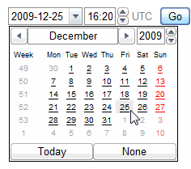
New in HTML 5
Semantic elements: nav, aside, header, footer, section, aside, article
Forms 2.0: sliders, search bars, color/number/email/url/date/time, placeholders, ...

Slide 39


New in HTML 5
Audio and video tags for embedding multimedia
Canvas tag for drawing 2D shapes in HTML/JS (like DrawingPanel) (ref 1, 2, 3)

Slide 40
New in HTML 5
semantic web / microdata attributes:
rel="...", itemscope, itemtype, itemprop
Accessibility features ("ARIA")
Embedding of rich XML-like formats such as SVG vector graphics
Other stuff:
offline apps, geolocation, cross-document messaging, MIME type registration, history management, ...

Slide 41
File Formats
Some differ in features (animation, 5.1 stereo, transparency)
Many multimedia formats use compression to reduce file size
compression algorithms are also called codecs (list
some compression algorithms are "lossless", others are "lossy"
Some formats are patented (unusable in free software)
Some formats are encrypted to protect information inside
Digital Rights Management (DRM) restricts what user can do with file
can be broken: DVD (DeCSS), HD DVD (09f911029d74e35bd84156c5635688c0)
Some formats are streaming (can play while downloading)

Slide 42
Image File Formats
JPEG : uses "lossy compression"; small file size; good for photos
GIF : 256 colors; LZW run-length encoding lossless compression
allows transparency (can see behind parts of image)
possible to create animated GIFs
PNG : free format created to avoid patent and color issues in GIF format; lossless compression, transparency
Others: TIFF, BMP
Image format comparisons: text, photo, PNG

Slide 43
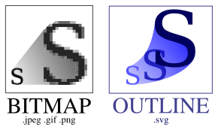
Raster and Vector Graphics
The image formats on the previous slide are raster or bitmap formats
Describe the pixels that should be drawn on the screen
vector graphics formats such as SVG
Describe shapes/lines rather than pixels
Advantage: infinite precision; good for zooming, printing
Disadvantage: not supported on all platforms; computationally expensive

Slide 44
Audio File Formats
MP3 : uses lossy compression that eliminates inaudible sounds
AAC : Apple's iTunes audio file format
WMA / ASF: Microsoft Windows Media Audio format
OGG : Linux hippie audio/video format
RA / RM / RAM : Real Audio format
Other formats: WAV (MS), AU (Sun), AIFF / SND (Apple), FLAC
Sequenced Music: MID, MOD

Slide 45
Video File Formats
MPEG : Motion Picture standard video format
DVDs are encoded using MPEG-2
HD DVDs are often compressed with MPEG-4 (H.264) codec
MOV : Apple's QuickTime movie format
WMV / ASF : Microsoft's Windows Media Video format
AVI : classic Microsoft video format that can be encoded in many ways
SWF / FLC : Macromedia Flash multimedia format
RV : Real Video format

Slide 46
Flash
Format for graphics, video, audio developed by Macromedia/Adobe
supported in most major platforms/browsers
lightweight
can produce impressive interactive animated content
downside: proprietary; editing software costs money (viewer is free)
examples: Duck Hunt, Homestar Runner

Slide 47
Linking to Multimedia Files
Browser has a list of default applications to associate with each file type
If it has an associated app, it will run it
Some file types are displayed within the browser using plugins
If it doesn't know what to do, it will just download the file
Try it yourself: MPG, MOV, WMV, RM, SWF, WAV, MID

Slide 48
File Types and Browser Plugins
Plugin: helper app launched within the browser to view certain file types
examples: Flash player, QuickTime, Windows Media Player, Acrobat Reader, Java
about:plugins URL will show you list of plugins in Firefox
enter preferences, then choose Content, File Types, Manage...
can change which app/plugin will be used to open particular file types

Slide 49
Embedded Objects: <object>
Replaces previous, non-standard embed element
Attributes: archive, classid, codebase, codetype, data, declare, height, name, standby, type, usemap, width
Type attribute specifies file's MIME type
IE6 requires non-standard classid attribute to specify which plugin to use (list)

Slide 50
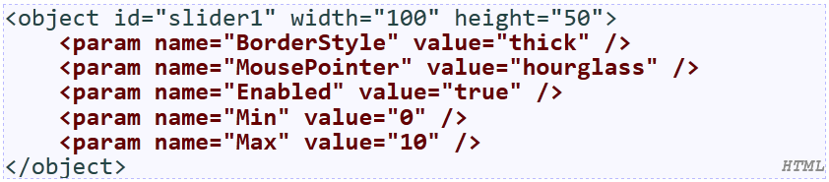
Embedded Objects: <object>
Indicates a parameter to be passed to the embedded object
Required name and value attributes tell the object what parameter this is and what value it should have

Slide 51
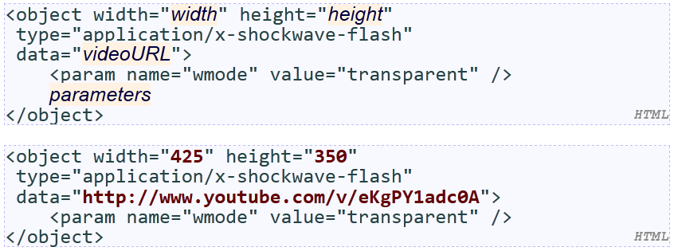
Embedding a YouTube Video

Slide 52
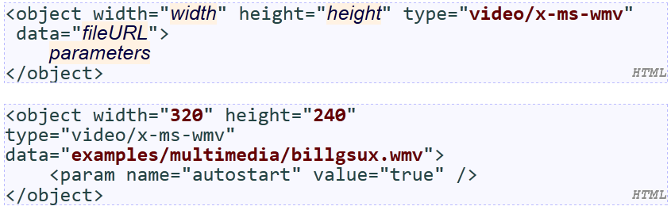
Embedding Windows Media

Slide 53
HTML 5 Embedding a Video

Slide 54
Self-Check
What HTML code would you use to make a page show the following:
Today’s HTML lesson:
To place a < in your page, write &lt; in the HTML.
To show an &, put &amp; instead.

Slide 55
Self-Check
Many HTML editing programs such as Dreamweaver or Microsoft FrontPage insert meta generator tags in documents you create with them, like this:
<meta name=“generator” content=“Microsoft FrontPage 6.0”/>
Why do you suppose they do this, even though the meta tag cannot be seen on the page?
Notes:
https://searchenginewatch.com/sew/how-to/2300239/metadata-you-best-practices-benefits-implementation-made-easy

Slide 56
In-class Assignment
Read Ch. 2 HTML Basics
Go to http://www.w3schools.com/tags/ and test sample codes in this chapter
Code files shown in the textbook: http://www.webstepbook.com/supplements-2ed.shtml#codefiles

Slide 57
Summary
HTML
HTML elements: inline or block
Should be chosen based on content rather than appearance in the browser
W3C HTML validator

